Slide 1
Permutation and combination-3
Special cases of row and circle arrangement –
1. Arranging boys and girls in a row or circle (2 heterogeneous groups such that elements within a group are all distinct)
2. Arranging books in a shelf
A. There are m identical and n identical books (2 heterogeneous groups such that all elements within the groups are similar)
B. There are m non-identical and n identical books
or
There are m identical and n non- identical books
(In B there are 2 heterogeneous group that such within 1 group all elements are similar and within the other group all elements are distinct)
3. Problems based on combination
4. Distribution of n identical objects in r non-identical groups

Slide 2
Special cases of row arrangement – case 2
In last ppt we discussed the case 1 of special case of row arrangement.
Case 1- When the total n objects can be divided in 2 different (heterogeneous) groups such that within a group some objects are similar (visually) and some are dissimilar
Problems based on arranging letters of a given word
Now we will discuss Case 2
Case 2- When the total n objects can be divided in 2 different (heterogeneous) groups such that within a group all elements are dissimilar (visually)
Problems based on arranging boys and girls in a row or circle
We can understand it with the help of some examples
Example 1- There are 10 boys and 7 girls in a class . In how many ways we can arrange the students in a row?
Example 2- There are 10 boys and 7 girls in a class . In how many ways we can arrange the students around a circular table such that no 2 girls are adjacent to each other?
In these 2 examples written above, the total number of students in a class is 17. These 17 students are divided in 2 heterogeneous (i.e. Different) groups (visually, we can say boys and girls can be differentiated visually). Now these 2 groups are boys (10) and girls (7). Now, within the group of 10 boys no 2 boys are similar (visually, so we are assuming that there are no identical twins among these 10 boys). Similarly, within the group of 7 girls no 2 girls are similar (visually, so we are assuming that there are no identical twins among these 7 girls)
In next slides we will solve some examples based on this concept

Slide 3
Examples- Arranging boys and girls in a row or circle
Case A- If number of objects (people) is not same in 2 heterogeneous groups
Directions for example 1-5: There are 10 boys and 7 girls in a class
Example 1- In how many ways we can arrange the students in a row?
Example 2- In how many ways we can arrange the students in a row such that no 2 girls are adjacent to each other?
Example 3- In how many ways we can arrange the students around a circular table?
Example 4- In how many ways we can arrange the students around a circular table such that no 2 girls are adjacent to each other?
Example 5- In how many ways we can arrange the students around a square table?
In all of these examples the number of students in 2 heterogeneous groups (i.e. Boys and girls) is different (10 and 7 respectively)

Slide 4
Solutions
Solution 1- There are total 17 students in a class. They can be arranged in a row in 17! Ways
Solution 2- We will first arrange 10 boys in a row in 10! Ways.
-B1-B2-B3-B4-B5-B6-B7-B8-B9-B10-
Now, if no 2 girls are adjacent to each other then the girls must take 9 positions in between 10 boys (for example there is 1 position between B1 and B2 and similarly there are such 9 positions in between 10 boys) or the extreme left position (left to B1) or the extreme right position (i.e. Right to B10). So, number of positions available to girls = 9 + 1+ 1 = 11
So, the 7 girls must be arranged in these 11 positions in 11P7 ways. (or we can say we will choose 7 places from these 11 in 11C7 ways and then will arrange girls in these 7 chosen places in 7! Ways. So, number of ways = 11C7 × 7! = 11P7)
So, required number of ways = 10! × 11P7
Solution 3- There are total 17 students in a class. They can be arranged around a circular table in (17-1)! = 16! ways
Solution 4- We will first arrange 10 boys around a circular table in (10-1)! = 9! Ways
Now this solution is exactly similar to solution 2 for available positions to girls with only 1 difference. In solution 2, there were extreme left and extreme right positions for girls. But, in circle the boys B1 and B10 will be adjacent to each other). So, instead of 2 extreme positions in row (extreme right and extreme left) there will be only 1 position (between B1 and B10) in circle arrangement. So, available positions for girls will be 10 (and not 11 like that in row arrangement).
So, the 7 girls must be arranged in these 10 positions in 10P7 ways. (or we can say we will choose 7 places from these 10 in 10C7 ways and then will arrange girls in these 7 chosen places in 7! Ways. So, number of ways = 10C7 × 7! = 10P7)
So, required number of ways = 9! × 10P7
Solution 5- We can arrange objects around any closed figure in the same way as in a circle. So, the number of ways in which the 17 students can be arranged around a square table is (17-1)! = 16!

Slide 5
Examples- Arranging boys and girls in a row or circle
Case B- If number of objects (people) is same in 2 heterogeneous groups
Directions for example 1-5: There are 7 boys and 7 girls in a class
Example 1- In how many ways we can arrange the students in a row?
Example 2- In how many ways we can arrange the students in a row such that no 2 girls are adjacent to each other?
Example 3- In how many ways we can arrange the students in a row such that no 2 boys are adjacent to each other?
Example 4- In how many ways we can arrange the students in a row such that neither 2 boys are adjacent to each other nor 2 girls are adjacent to each other?
Example 5- In how many ways we can arrange the students around a circular table?
Example 6- In how many ways we can arrange the students around a circular table such that no 2 girls are adjacent to each other?
Example 7- In how many ways we can arrange the students around a circular table such that no 2 boys are adjacent to each other?
Example 8- In how many ways we can arrange the students around a circular table such that neither 2 boys are adjacent to each other nor 2 girls are adjacent to each other?
Example 9- In how many ways we can arrange the students around a square table?
In all of these examples the number of students in 2 heterogeneous groups (i.e. Boys and girls) is same (7 and 7 respectively)

Slide 6
Solution 1- There are total 14 students in a class. They can be arranged in a row in 14! Ways
Solution 2-We will first arrange 7 boys in a row in 7! Ways.
-B1-B2-B3-B4-B5-B6-B7-
Now, if no 2 girls are adjacent to each other then the girls must take 6 positions in between 7 boys (for example there is 1 position between B1 and B2 and similarly there are such 6 positions in between 7 boys) or the extreme left position (left to B1) or the extreme right position (i.e. Right to B7). So, number of positions available to girls = 6 + 1+ 1 = 8
So, the 7 girls must be arranged in these 8 positions in 8P7 ways. (or we can say we will choose 7 places from these 7 in 8C7 ways and then will arrange girls in these 7 chosen places in 7! Ways. So, number of ways = 8C7 × 7! = 8P7)
So, required number of ways = 7! × 8P7
Solution 3- We will first arrange 7 girls in a row in 7! Ways.
-G1-G2-G3-G4-G5-G6-G7-
Now, if no 2 boys are adjacent to each other then the boys must take 6 positions in between 7 girls (for example there is 1 position between G1 and G2 and similarly there are such 6 positions in between 7 girls) or the extreme left position (left to G1) or the extreme right position (i.e. Right to G7). So, number of positions available to boys = 6 + 1+ 1 = 8
So, the 7 boys must be arranged in these 8 positions in 8P7 ways. (or we can say we will choose 7 places from these 7 in 8C7 ways and then will arrange boys in these 7 chosen places in 7! Ways. So, number of ways = 8C7 × 7! = 8P7)
So, required number of ways = 7! × 8P7

Slide 7
Example 4- In how many ways we can arrange the students in a row such that neither 2 boys are adjacent to each other nor 2 girls are adjacent to each other?
Solution 4- We cannot use the approach used in solution 2 and solution 3 of first arranging 7 boys (or girls) in 7! Ways and then arranging the 7 girls (or boys) in 8 available positions. Why?
For example if we use approach of solution 2, we fixed 7 boys in a row in 7! Ways and now we will choose 7 positions from available 8 positions for girls. Suppose, we left any of the 6 positions between 7 boys (i.e. We have chose both the extreme left position and the extreme right position and 5 from remaining 6). Let us assume space between B1 and B2 is not chosen, then B1 and B2 will be adjacent to each other
(similarly approach of solution 3 will be resulted in 2 girls being adjacent to each other)
So, you please try some approach to solve this example and discuss with me via whatsapp or by calling me.
Solution 5- There are total 14 students in a class. They can be arranged around a circular table in (14-1)! = 13! ways
Solution 6- We will first arrange 7 boys around a circular table in (7-1)! = 6! Ways
There will be 7 positions in between 7 boys. If we want no 2 girls to be adjacent to each other, then the 7 girls must occupy these 7 positions. The girls can occupy these positions in 7! ways (can be obtained by MNP rule or Permutation or by using combination and then arrangement (by first selecting 7 positions from 7 available positions in 7C7 (=1) way and then arranging girls in these 7 chosen positions in 7! Ways)
So, the 7 girls must be arranged in these 7 available positions in 7! (= 7P7) ways.
So, required number of ways = 6! × 7!

Slide 8
Solutions
Solution 7- We will first arrange 7 girls around a circular table in (7-1)! = 6! Ways
There will be 7 positions in between 7 girls. If we want no 2 boys to be adjacent to each other, then the 7 boys must occupy these 7 positions. The boys can occupy these positions in 7! ways (can be obtained by MNP rule or Permutation or by using combination and then arrangement (by first selecting 7 positions from 7 available positions in 7C7 (=1) way and then arranging boys in these 7 chosen positions in 7! Ways)
So, the 7 boys must be arranged in these 7 available positions in 7! (= 7P7) ways.
So, required number of ways = 6! × 7!
Solution 8- This example can be solved by the same approach as example 6 (by first arranging boys and then girls) or by approach of example 7 (by first arranging girls and then boys). In either case, answer will be same i.e. 6! × 7!.
We cannot use this approach in row arrangement, but we can use it in circle arrangement. Try to understand this difference
Solution 9- We can arrange objects around any closed figure in the same way as in a circle. So, the number of ways in which the 14 students can be arranged around a square table is (14-1)! = 13!

Slide 9
Special cases of row arrangement – case 3
We have already discussed the case 1 and case 2. Now we will discuss Case 3
Case 2- When the total n objects can be divided in 2 different (heterogeneous) groups such that –
A. within both the groups all elements are similar (visually)
B. within 1 group all elements are similar (visually) and within other group all elements are dissimilar (visually)
There is no case C in which we can say within both the groups all objects are dissimilar, as it will be exactly same as Case 2
Problems based on arranging books in a library in a shelf (in a row)
We can understand it with the help of some examples
Example 1- There are 10 identical GK books and 7 identical History books in a library . In how many ways we can arrange the books in a shelf (in a row)?
Example 2- There are 10 identical GK books and 7 identical History books in a library. In how many ways we can arrange the books in a shelf (in a row) such that no 2 History books are adjacent to each other?
Example 3- There are 10 non-identical GK books and 7 identical History books in a library . In how many ways we can arrange the books in a shelf (in a row) such that no 2 History books are adjacent to each other?
Example 4- There are 10 identical GK books and 7 non-identical History books in a library. In how many ways we can arrange the books in a shelf (in a row) such that no 2 History books are adjacent to each other?
The example 1 and 2 are based on case A. There are total 17 objects (i.e. Books) which can be divided in 2 heterogeneous i.e. Different groups (visually i.e. GK books and History books). Within the group of GK books all 10 books are similar (visually, so they are 100% identical).Similarly, within the group of History books all 7 books are similar (visually, so they are 100% identical).
The example 3 and 4 are based on case B.
In example 3, within the group of GK books all 10 books are dissimilar (visually, so they are non-identical).But, within the group of History books all 7 books are similar (visually, so they are 100% identical).
In example 4, within the group of GK books all 10 books are similar (visually, so they are 100% identical).But, within the group of History books all 7 books are dissimilar (visually, so they are non-identical).

Slide 10
Examples based on special cases of row arrangement – case 3
Case A- within both the groups all elements are similar (visually)
(Example 1-2)
Directions for example 1-2: There are 10 identical GK books and 7 identical History books in a library.
Example 1- In how many ways we can arrange the books in a shelf (in a row)?
Example 2- In how many ways we can arrange the books in a shelf (in a row) such that no 2 History books are adjacent to each other?
Case B- within 1 group all elements are similar (visually) and within other group all elements are dissimilar (visually)
(Example 3-6)
Directions for example 3-4: There are 10 identical GK books and 7 non-identical History books in a library.
Example 3- In how many ways we can arrange the books in a shelf (in a row)?
Example 4- In how many ways we can arrange the books in a shelf (in a row) such that no 2 History books are adjacent to each other?
Directions for example 5-6: There are 10 non-identical GK books and 7 identical History books in a library.
Example 5- In how many ways we can arrange the books in a shelf (in a row)?
Example 6- In how many ways we can arrange the books in a shelf (in a row) such that no 2 History books are adjacent to each other?

Slide 11
Solutions
Solution 1- There are total 17 objects such that 10 are identical and remaining 7 are identical. We need to arrange these 17 objects in a row. So, we can use formula n!/p!q!r! (where n=17, p=10 and q=7 and r=1)
So, required number of ways = 17!/(10!7!)
Solution 2-We will first arrange 10 identical GK books in a row in 10!/10! Ways.
-GK1-GK2-GK3-GK4-GK5-GK6-GK7-GK8-GK9-GK10-
Now, if no 2 History books are adjacent to each other then the History books must take 9 positions in between 10 identical GK books (for example there is 1 position between GK1 and GK2 and similarly there are such 9 positions in between 10 identical GK books ) or the extreme left position (left to GK1) or the extreme right position (i.e. Right to GK10). So, number of positions available to 7 identical History books = 9 + 1+ 1 = 11
So, the 7 identical History books must be arranged in these 11 positions in 11P7/7! = 11C7 ways. (or we can say we will choose 7 places from these 11 in 11C7 ways and then will arrange 7 identical History books in these 7 chosen places in 7!/7! Ways. So, number of ways = 11C7 × 7!/7! = 11C7)
So, required number of ways = (10!/10!) × 11C7 = 11C7
Solution 3- There are total 17 objects such that 10 are identical and remaining 7 are non-identical. We need to arrange these 17 objects in a row. So, we can use formula n!/p!q!r! (where n=17, p=10 and q=1 and r=1)
So, required number of ways = 17!/10!

Slide 12
Solutions
Solution 4-We will first arrange 10 identical GK books in a row in 10!/10! Ways.
-GK1-GK2-GK3-GK4-GK5-GK6-GK7-GK8-GK9-GK10-
Now, if no 2 History books are adjacent to each other then the History books must take 9 positions in between 10 identical GK books (for example there is 1 position between GK1 and GK2 and similarly there are such 9 positions in between 10 identical GK books ) or the extreme left position (left to GK1) or the extreme right position (i.e. Right to GK10). So, number of positions available to 7 non-identical History books = 9 + 1+ 1 = 11
So, the 7 non-identical History books must be arranged in these 11 positions in 11P7 (or we can say we will choose 7 places from these 11 in 11C7 ways and then will arrange 7 non-identical History books in these 7 chosen places in 7! Ways. So, number of ways = 11C7 × 7! = 11P7)
So, required number of ways = (10!/10!) × 11P7 = 11P7
Solution 5- There are total 17 objects such that 10 are non-identical and remaining 7 are identical. We need to arrange these 17 objects in a row. So, we can use formula n!/p!q!r! (where n=17, p=7 and q=1 and r=1)
So, required number of ways = 17!/7!
Solution 6-We will first arrange 10 non-identical GK books in a row in 10! Ways.
-GK1-GK2-GK3-GK4-GK5-GK6-GK7-GK8-GK9-GK10-
Now, if no 2 History books are adjacent to each other then the History books must take 9 positions in between 10 non-identical GK books (for example there is 1 position between GK1 and GK2 and similarly there are such 9 positions in between 10 non-identical GK books ) or the extreme left position (left to GK1) or the extreme right position (i.e. Right to GK10). So, number of positions available to 7 identical History books = 9 + 1+ 1 = 11
So, the 7 identical History books must be arranged in these 11 positions in 11C7 (or we can say we will choose 7 places from these 11 in 11C7 ways and then will arrange 7 identical History books in these 7 chosen places in 7!/7! Ways. So, number of ways = 11C7 × 7!/7! = 11C7)
So, required number of ways = 10! × 11C7

Slide 13
Combination
We already discussed combination in ppt-1. Now, we will solve some problems based on combination.
We will use formula and concept of AND, OR to solve problems based on Combination
If there are n distinct objects and we need to choose r such that-
(I)- k number of objects must be selected. In such a case there is choice of choosing r-k objects from n-k objects
So, number of choices are = (n-k)C(r-k)
(B)- k number of objects cannot be selected. In such a case there is choice of choosing r objects from n-k objects
So, number of choices are = (n-k)C(r)
Similarly we can make changes in formula for combination i.e. nCr depending on the given condition
Number of ways of choosing at least 1 from n
If there are total n distinct objects and we need to choose at least 1 from n objects, then the total number of ways of choosing it are
nC0 + nC1 + nC2 +.........+nC(n-1) + nCn = (2^n)
So, nC1 + nC2 +.........+nC(n-1) + nCn = (2^n) -1
(nC0 = 1)

Slide 14
Examples on Combinations
Example 1- A student appears for an exam in which he has to attempt 4 questions in total. There are 2 sections given. Section 1 has 4 questions in which 2 particular questions have to be definitely attempted. Section 2 has 4 questions. In how many ways can the student attempt the paper?
Example 2- In how many ways can 3 numbers be selected from the first 20 natural numbers such that exactly one of them is a multiple of 6?
Example 3- In a pack of 52 playing cards,4 cards are chosen. In how many ways all of these four card are of the same suit?
Directions for question number 4-5: A committee of 7 is to be formed out of 7 gents and 5 ladies. In how many ways this can be done
Example 4- If at least three ladies are included?
Example 5- If at most two ladies are included?
Example 6- A boy goes to a birthday party where 4 dishes have been laid out. In how many ways he can select at least one dish ?

Slide 15
Solutions
Solution 1- There are total 8 questions and student has to attempt 4 questions. Section 1 has 4 questions in which 2 particular questions have to be definitely attempted. So, there is no choice for these questions. So, there is choice of choosing 2 questions from 6 questions.
So, number of ways in which question paper can be attempted is 6C2
Solution 2- There are 3 multiples of 6 in first 20 natural numbers (i.e. 6, 12 and 18). We need to choose 3 numbers in first 20 natural numbers such that there is exactly 1 multiple of 6.
So, choice is - 1 from 3 and 2 from 17 = 3C1 and 17C2 = 3C1 × 17C2
Solution 3- There are 4 suits (of 13 cards each) in game of card. These suits are – Spade, Club, Heart and Diamond. We can understand the situation in AND, OR as-
4 cards of Spade or 4 cards of Club or 4 cards of Heart or 4 cards of Diamond
13C4 + 13C4 + 13C4 + 13C4 = 4 × (13C4)
Solution 4 – It can be solved by using AND, OR as-
At least 3 ladies = 3 ladies or 4 ladies or 5 ladies = (3 ladies and 4 gents ) or (4 ladies and 3 gents )or (5 ladies and 2 gents) =
(5C3 and 7C4) or (5C4 and 7C3) or (5C5 and 7C2) = (5C3 × 7C4) + (5C4 × 7C3) + (5C5 × 7C2)
Solution 5- It can be solved by using AND, OR as-
At most 2 ladies = 0 lady or 1 lady or 2 ladies = (0 lady and 7 gents ) or (1 lady and 6 gents ) or (2 ladies and 5 gents) =
(5C0 and 7C7) or (5C1 and 7C6) or (5C2 and 7C5) = (5C0 × 7C7) + (5C1 × 7C6) + (5C2 × 7C5) = 1 + 35 + 210 = 246
Solution 6- We need to find the number of ways in which in can choose at least 1 from 4 distinct objects. So, n = 4. Hence, the required number of choices are = (2^4) -1 = 16-1 = 15

Slide 16
Distribution
A. n identical objects to r non-identical groups
B. n non-identical objects to r non-identical groups

Slide 17
A. Distribution of n identical objects in r non-identical groups
In this case we will find the number of ways in which we can distribute n identical objects among r non-identical groups. For example we want to distribute 10 identical chocolates(visually) among 4 kids (non-identical)
Let 3 identical chocolates are to be distributed among 3 kids (non-identical) – A, B and C
Case 1- If any number of objects can be given to any group (so we can give 0 to any number of groups)
If any group can get 0 (i.e. If any number of kids can get 0 chocolate in our example)
The possible number of ways of distribution = (n+r-1)C(r-1)
(In our example = (3+3-1)C(3-1) = 5C2 = 10
It can be shown below with number of chocolates given to A, B and C in each case
Case 1- 3,0,0; Case 2- 0,3,0; Case 3- 0,0,3; Case 4- 2,1,0; Case 5- 2,0,1;
Case 6- 1,2,0; Case 7 – 1,0,2; Case 8 -0,2,1; Case 9 - 0,1,2; Case 10 -1,1,1
Case 1- If at least 1 object must be given to each group (so we cannot give 0 to any group)
If each group must get at least 1 object (i.e. If each kid must get at least 1 chocolate in our example)
The possible number of ways of distribution = (n-1)C(r-1)
(In our example = (3-1)C(3-1) = 2C2 = 1
It can be shown below with number of chocolates given to A, B and C in each case
Case 1-1,1,1
(in above case there were 10 possible cases, but in 9 cases at least 1 kid got 0 chocolate)

Slide 18
A. Examples on Distribution of n identical objects in r non-identical groups
Example 1- In how many ways we can distribute 10 identical chocolates among 4 kids?
Example 2- In how many ways we can distribute 10 identical chocolates among 4 kids if each kid must get at least 1 chocolate?
Example 3- A + B + C = 12
How many solutions are possible for the above equation if A, B and C are whole numbers?
Example 4- A + B + C = 12
How many solutions are possible for the above equation if A, B and C are natural numbers?

Slide 19
A. Solutions
Solution 1- This is a distribution of identical objects based problem with n=10 and r=4. There is no condition given to us. So, we need to find total number of possible cases (including the cases in which 0 can be given)
So, required number of ways = (n+r-1)C(r-1) = (10+4-1)C(4-1) = 13C3
Solution 2- This is a distribution of identical objects based problem with n=10 and r=4. Each kid must get at least 1 chocolate and so it is he case in which each group must get at least 1 object
So, required number of ways = (n-1)C(r-1) = (10-1)C(4-1) = 9C3
Solution 3- This is a distribution of identical objects based problem with n=12 and r=3. A, B and C are whole numbers and so 0 can be given. So, we need to find total number of possible cases (including the cases in which 0 can be given)
So, required number of ways = (n+r-1)C(r-1) = (12+3-1)C(3-1) = 14C2
Solution 4- This is a distribution of identical objects based problem with n=12 and r=3. A, B and C are natural numbers and so 0 cannot be given. So, we need to find the number of possible cases in which each group must get at least 1 object
So, required number of ways = (n-1)C(r-1) = (12-1)C(3-1) = 11C2

Slide 20
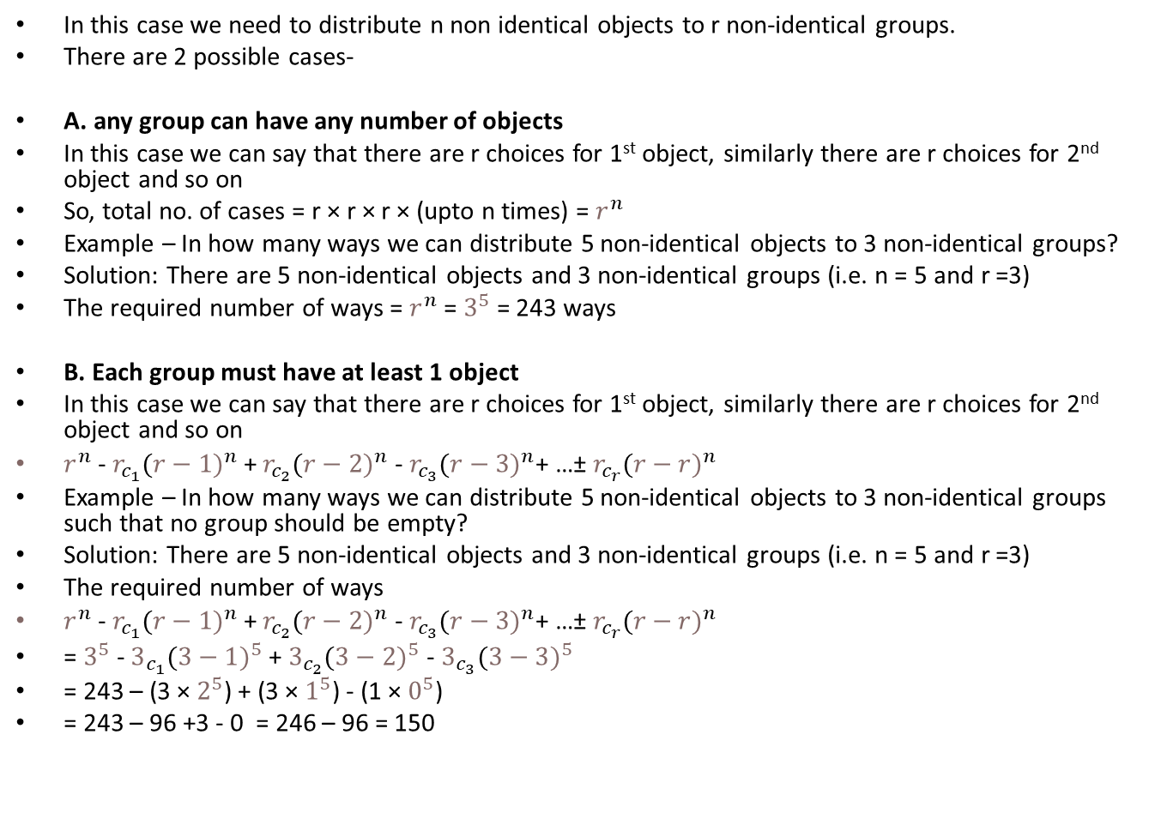
B. n non-identical objects to r non-identical groups
In this case we need to distribute n non identical objects to r non-identical groups.
There are 2 possible cases-
A. any group can have any number of objects
In this case we can say that there are r choices for 1st object, similarly there are r choices for 2nd object and so on
So, total no. of cases = r × r × r × (upto n times) = $r^{n}$
Example – In how many ways we can distribute 5 non-identical objects to 3 non-identical groups?
Solution: There are 5 non-identical objects and 3 non-identical groups (i.e. n = 5 and r =3)
The required number of ways = $r^{n}$ = $3^{5}$ = 243 ways
B. Each group must have at least 1 object
In this case we can say that there are r choices for 1st object, similarly there are r choices for 2nd object and so on
$r^{n}$ - $r_{c_{1}}({r−1)}^{n}$+ $r_{c_{2}}({r−2)}^{n}$ - $r_{c_{3}}({r−3)}^{n}$+ …± $r_{c_{r}}({r−r)}^{n}$
Example – In how many ways we can distribute 5 non-identical objects to 3 non-identical groups such that no group should be empty?
Solution: There are 5 non-identical objects and 3 non-identical groups (i.e. n = 5 and r =3)
The required number of ways
$r^{n}$ - $r_{c_{1}}({r−1)}^{n}$+ $r_{c_{2}}({r−2)}^{n}$ - $r_{c_{3}}({r−3)}^{n}$+ …± $r_{c_{r}}({r−r)}^{n}$
= $3^{5}$ - $3_{c_{1}}({3−1)}^{5}$+ $3_{c_{2}}({3−2)}^{5}$ - $3_{c_{3}}({3−3)}^{5}$
= 243 – (3 × $2^{5}$) + (3 × $1^{5}$) - (1 × $0^{5}$)
= 243 – 96 +3 - 0 = 246 – 96 = 150

Slide 21
Examples- n non-identical objects to r non-identical groups
Example 1- In how many ways we can distribute 6 non-identical pens among 4 faculty members?
Example 2- In how many ways we can distribute 6 non-identical pens among 4 faculty members if each faculty member must get at least 1 pen?

Slide 22
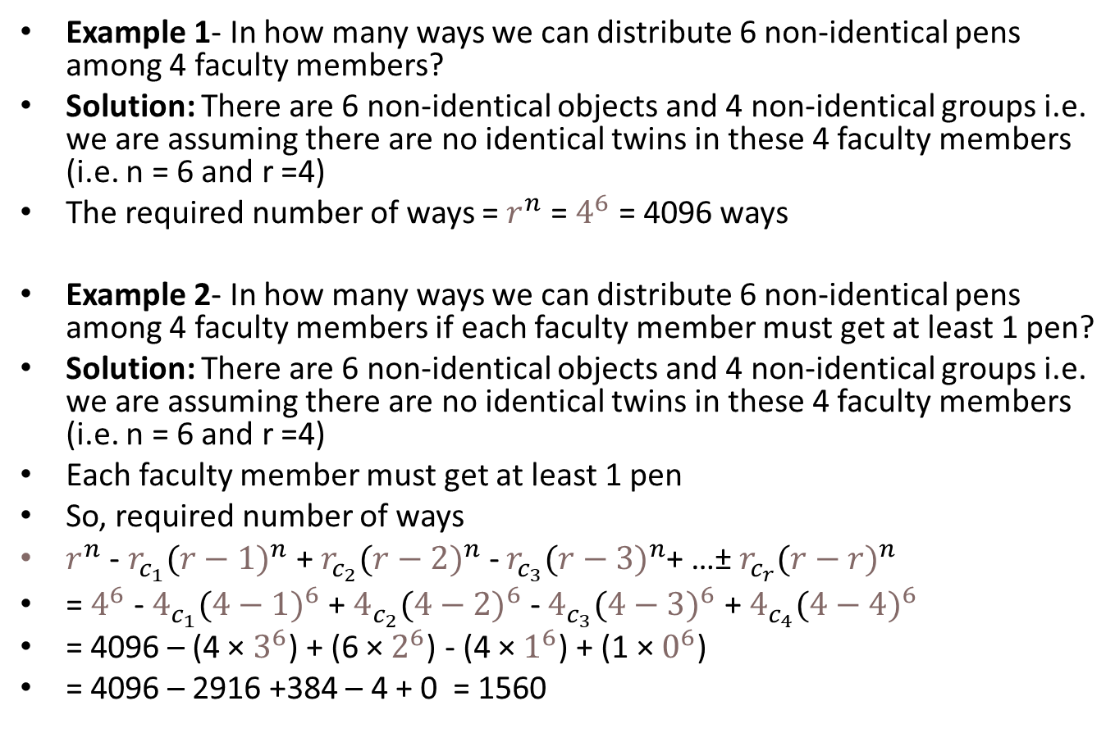
Examples- n non-identical objects to r non-identical groups
Example 1- In how many ways we can distribute 6 non-identical pens among 4 faculty members?
Solution: There are 6 non-identical objects and 4 non-identical groups i.e. we are assuming there are no identical twins in these 4 faculty members (i.e. n = 6 and r =4)
The required number of ways = $r^{n}$ = $4^{6}$ = 4096 ways
Example 2- In how many ways we can distribute 6 non-identical pens among 4 faculty members if each faculty member must get at least 1 pen?
Solution: There are 6 non-identical objects and 4 non-identical groups i.e. we are assuming there are no identical twins in these 4 faculty members (i.e. n = 6 and r =4)
Each faculty member must get at least 1 pen
So, required number of ways
$r^{n}$ - $r_{c_{1}}({r−1)}^{n}$+ $r_{c_{2}}({r−2)}^{n}$ - $r_{c_{3}}({r−3)}^{n}$+ …± $r_{c_{r}}({r−r)}^{n}$
= $4^{6}$ - $4_{c_{1}}({4−1)}^{6}$+ $4_{c_{2}}({4−2)}^{6}$ - $4_{c_{3}}({4−3)}^{6}$ + $4_{c_{4}}({4−4)}^{6}$
= 4096 – (4 × $3^{6}$) + (6 × $2^{6}$) - (4 × $1^{6}$) + (1 × $0^{6}$)
= 4096 – 2916 +384 – 4 + 0 = 1560

Slide 23
Dictionary order based problems
This topic is best understood with example. So, careful observation of example shown below is necessary.
Example: What would be the rank of the word SUDDEN, if all possible permutations of word success are arranged as per the dictionary?
Solution: There are 6 letters (S, U, 2D, E and N)
The alphabetic order for these letters – D, E, N, S and U
Clearly, in this case there are 6 positions to be filled by 6 letters (while 2 letters are repeated)
The word SUDDEN starts with S
So, we need to consider the number of words which starts with D, E and N (the letters before S in alphabetic order)
(i) The words with D as 1st letter (D_ _ _ _ _)
In this case D is fixed at 1st position. So, now we need to fill 5 positions with 5 distinct letters (S, U, D, E and N). So, number of words = 5!
(ii) The words with E as 1st letter (E_ _ _ _ _)
In this case E is fixed at 1st position. So, now we need to fill 5 positions with 5 letters such that 2 are identical (S, U, 2D and N). So, number of words = 5!/2!
(iii) The words with N as 1st letter (N_ _ _ _ _)
In this case N is fixed at 1st position. So, now we need to fill 5 positions with 5 letters such that 2 are identical (S, U, 2D and E). So, number of words = 5!/2!
Now S is used at 1st position (S _ _ _ _ _)
The 2nd letter in SUDDEN is U. But, if we focus of dictionary ranking of words, it is clear that the words with D, E or N at 2nd position will come before U at 2nd position

Slide 24
Dictionary order based problems
(iv) Number of words with S at 1st position and D at 2nd position (SD _ _ _ _)
In this case S and D are fixed at 1st and 2nd positions respectively. So, now we need to fill 4 positions with 4 distinct letters ( U, D, E and N). So, number of words = 4!
(v) Number of words with S at 1st position and E at 2nd position (SE _ _ _ _)
In this case S and E are fixed at 1st and 2nd positions respectively. So, now we need to fill 4 positions with 4 letters such that 2 are identical ( U, 2D and N). So, number of words = 4!/2!
(vi) Number of words with S at 1st position and N at 2nd position (SN _ _ _ _)
In this case S and N are fixed at 1st and 2nd positions respectively. So, now we need to fill 4 positions with 4 letters such that 2 are identical ( U, 2D and E). So, number of words = 4!/2!
Now S and U are used at 1st and 2nd positions respectively (SU _ _ _ _)
The 3rd, 4th, 5th and 6th letters in SUDDEN are D, D, E and N. So, these are now already arranged as per dictionary order. So, the next word as per dictionary order is SUDDEN
Thus, rank of the word SUDDEN = 5! + (5!/2!) + (5!/2!) + 4! + (4!/2!) + (4!/2!) + 1
= 120 + 60 + 60 + 24 + 12 + 12 + 1 = 289

Slide 25
Problems on dictionary order – practice questions
Example 1- What would be the rank of the word SUCCESS, if all possible permutations of word success are arranged as per the dictionary?
Example 2- What would be the rank of the word INDIAN, if all possible permutations of word INDIAN are arranged as per the dictionary?

Slide 26
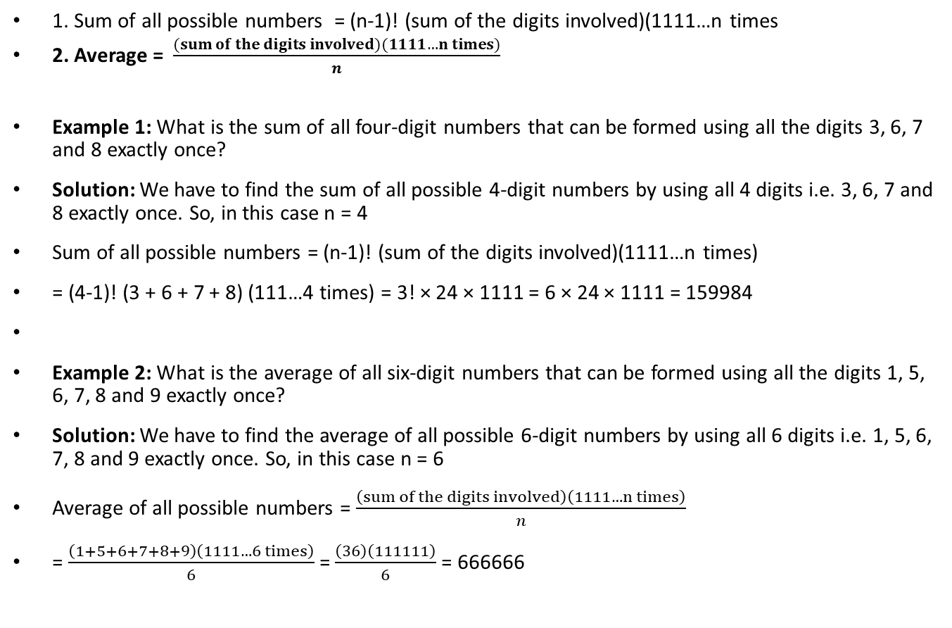
C. Sum and average of all the numbers formed by using the given digits exactly once
1. Sum of all possible numbers = (n-1)! (sum of the digits involved)(1111…n times
2. Average = $\frac{(sum of the digits involved)(1111…n times)}{n}$
Example 1: What is the sum of all four-digit numbers that can be formed using all the digits 3, 6, 7 and 8 exactly once?
Solution: We have to find the sum of all possible 4-digit numbers by using all 4 digits i.e. 3, 6, 7 and 8 exactly once. So, in this case n = 4
Sum of all possible numbers = (n-1)! (sum of the digits involved)(1111…n times)
= (4-1)! (3 + 6 + 7 + 8) (111…4 times) = 3! × 24 × 1111 = 6 × 24 × 1111 = 159984
Example 2: What is the average of all six-digit numbers that can be formed using all the digits 1, 5, 6, 7, 8 and 9 exactly once?
Solution: We have to find the average of all possible 6-digit numbers by using all 6 digits i.e. 1, 5, 6, 7, 8 and 9 exactly once. So, in this case n = 6
Average of all possible numbers = $\frac{\left(sum of the digits involved\right)\left(1111…n times\right)}{n}$
= $\frac{\left(1+5+6+7+8+9\right)\left(1111…6 times\right)}{6}$ = $\frac{\left(36\right)\left(111111\right)}{6}$ = 666666

Slide 27
Sum of all numbers formed
The sum of all the 5 digit numbers formed by odd digits such that repetition of digits is not allowed?

Slide 28
Derangement
In simple words, a derangement is a permutation of n objects in such a way that no object appears in its original position.
The problem of counting derangements was first considered in 1708 and eventually solved in 1713 by Pierre Raymond de Montmort. Nicholas Bernoulli also solved it at about the same time.
The arrangement of n people in a row (assuming all are non-identical) is possible in n! ways.
For example: 1-A 2-B 3-C 4-D
In this case 4 positions in a row are occupied by A, B, C and D respectively
There are 3 cases:
Case 1- Every person occupied the correct position (it is 1-A 2-B 3-C 4-D)
There is only 1 such case
Case 2- Maximum 3 and minimum 3 people occupied correct position
So, in this case at least 1 person got correct position and at least 1 person got the incorrect position
Hence, not all got correct position and not all got incorrect position
Example-
(i) 1-B 2-D 3-C 4-A. In this case only C got correct position and rest 3 got incorrect positions
(ii) 1-A 2-C 3-B 4-D. In this case A and D got correct position while B and C got incorrect positions
Case 3- Every person occupied the incorrect position
Example- (i) 1-B 2-C 3-D 4-A; (ii) 1-D 2-C 3-B 4-A
The case 3 shown above is derangement. If we see the example above there were 4 people. So, there are total 4! i.2. 24 possible arrangements and 1 of them is correct. From remaining 23 all are not cases of derangement as shown above.
So, we need concept of derangement for 2 types of counting:
(a) Number of derangements (example 50)
(b) Number of cases where some got correct while some got incorrect positions (example 51)

Slide 29
Formula for derangement
The number of derangements of a set of n onjects is denoted as D_{n} and its formula is given below

Slide 30
Examples on Derangement

